Slide 1
Farm Sites Features Exploration -Mayaguez, Puerto Rico
Jingzhe Wang
3/6/2018

Slide 2
Motivation
Derived from a previous project on organic farm site selection
Context about organic farming :
Enhance the resilient capacity facing extreme events such as Hurricane (Jouzi et al., 2016)
Help reduce the unemployment rate (Jouzi et al., 2016)
A great portion of production expenses goes to labors; competitive wages (USDA, 2012 & 2015)
Choose Area of Interest (AOI) in the forest region located in the mountain area of Mayaguez, western Puerto Rico based on the location of one known organic farm information

Slide 3
Data preparation
Data search and data prepossessing were done
Aim to explore the physical environment features for the existing organic farms, compare with the ones of non-farm areas or non-organic farms → very limited information
Better remove the ‘organic’ limitation first
One organic farm site on the AOI, two other farm sites found on the satellite image of the AOI
Randomly specified three polygon areas on the satellite image which looked like residential area
Extract points from three farm areas and three non-farm areas to form the observations

Slide 4
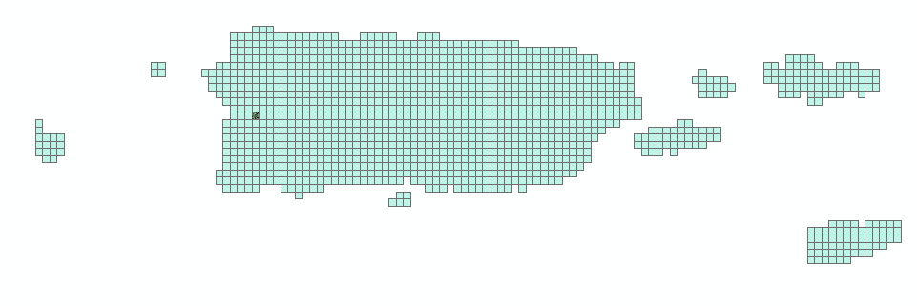
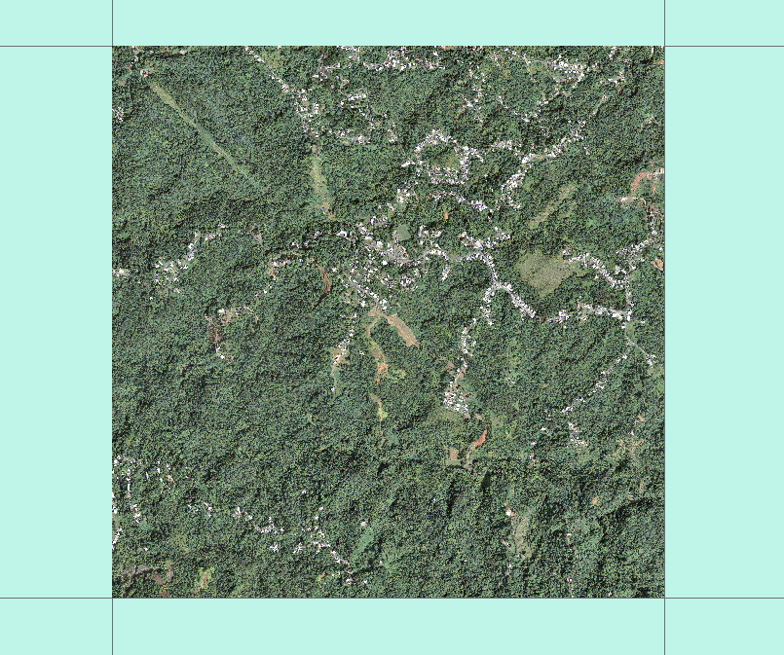
Source: U.S. Geological Survey USGS, 2009

Slide 5
Data and Methods
Response: farmland (binary, ‘Yes’ or ‘No’)
Variables:
Factor variables: stype (soil type, 7 levels), landcover(4 levels),
Numeric or integer: organic_percent, avail_water, slope, canopy(tree canopy coverage rate)
XY-Coordinate
Spatial autocorrelations as location points from the same location area (polygon) will have similar or same attribute values
Common parametric regression models might not be good choice
Focus on single decision tree and bagging methods

Slide 6
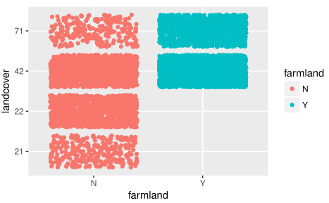
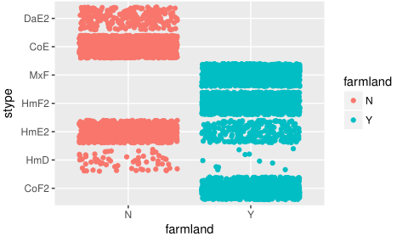
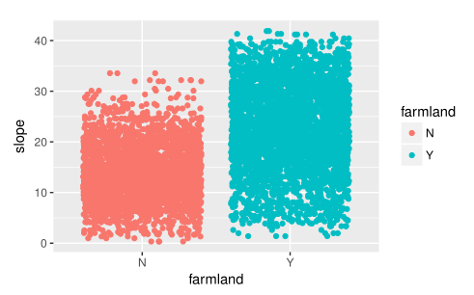
Scatterplots

Slide 7
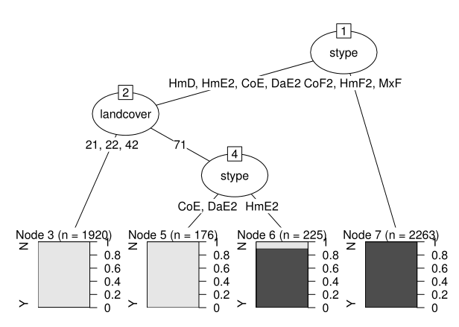
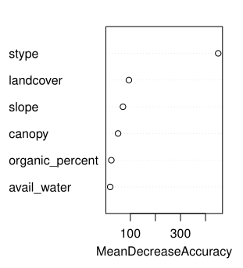
Decision Tree and Bagging
Soil type and landcover type are important ; cp = 0.01
Misclassification rate on test set: 0.92%
No misclassification on test set

Slide 8
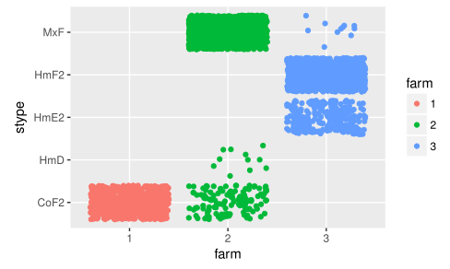
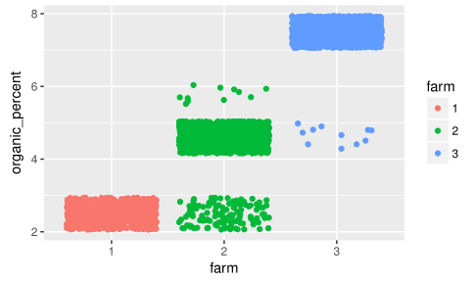
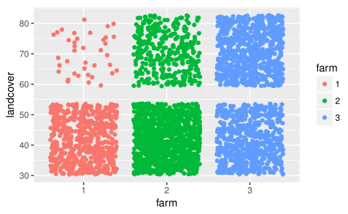
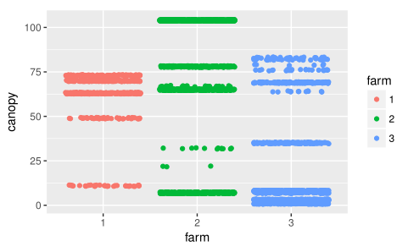
Comparing Three Farm Sites

Slide 9
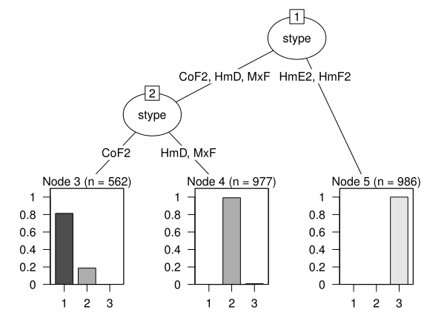
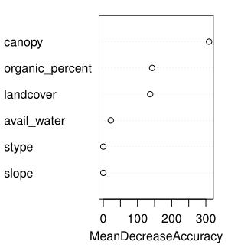
Comparing Three Farm Sites
Canopy is important
Soil type is important
cp = 0.03
Misclassification rate on test set: 2.97%
No misclassification on test set

Slide 10
Conclusion based on the sample
To distinguish farmland from non-farmland:
Soil type: CoF2, HmF2, MxF, HmE2
Landcover type:
avoid 21 (developed, open space), 22 (developed, low intensity), 42 (evergreen forest); 71 (grassland/herbaceous) may be neutral
For three farms (farm3 is the organic farm):
Soil type: HmE2 and HmF2 for organic farm
Tree canopy coverage rate may be important (tried if not prune the tree)

Slide 11

Insights
Different results from single decision tree and bagging
More likely to pick location points from farm2 and farm3 rather than farm1 during the
resampling process. The resulting decision trees will have fairly different important
variables be selected then as the variance for each single decision tree is high.
Non-farmland points all from residential area, non-farmland is not necessarily residential area; limited information about other non-farmland types
Sample location points were from six polygon areas, they might not be representative for the whole AOI (e.g. some different kinds of soil are in other locations)
Regression might be really helpful for assigning weights to different spatial attributes → weighted overlay methods

Slide 12
References
Farm Economics Record high agriculture sales; income and expenses both up., Highlights, 2012 Census of Agriculture, United States Department of Agriculture, 2014. Retrieved from https://www.agcensus.usda.gov/Publications/2012/Online_Resources/Highlights/Farm_Economics/
How Weighted Overlay Works, Tool Reference, ArcGIS Desktop (2017). Retrieved from http://pro.arcgis.com/en/pro-app/tool-reference/spatial-analyst/how-weighted-overlay-works.htm
Jouzi, Z., Azadi, H., Taheri, F., Zarafshani , K., Gebrehiwot, K., Passel, S. V., & Lebailly, P. (2017). Organic Farming and Small-Scale Farmers: Main Opportunities and Challenges. Ecological Economics, Elsevier, 132, 144–154. Retrieved from https://doi.org/10.1016/j.ecolecon.2016.10.016
Organic Farming Results from 2014 Organic Survey, Highlights, 2012 Census of Agriculture, United States Department of Agriculture, 2015. Retrieved from https://www.agcensus.usda.gov/Publications/2012/Online_Resources/Organics/index.php
Soil Survey Staff, Soil Survey Geographic (SSURGO) database for Mayaguez Area, Puerto Rico Western Part, Natural Resources Conservation Service, United States Department of Agriculture. Web Soil Survey. Available online at the following link: https://websoilsurvey.sc.egov.usda.gov/ . Accessed [11/25/2017].

Slide 13
Soil Survey staff, Natural Resources Conservation Service ,United States Department of Agriculture. Retrieved from
https://www.nrcs.usda.gov/Internet/FSE_MANUSCRIPTS/puerto_rico/PR686/0/San_Juan.pdf
U.S. Geological Survey, 2009. High Resolution Orthoimagery: 2739264_PUERTORICO20100531. https://lta.cr.usgs.gov/high_res_ortho
U.S. Department of the Interior, U.S. Geological Survey, 2013. Land Cover 100 Meter Resolution-Puerto Rico and the U.S. Virgin Islands, Albers Projection.
https://nationalmap.gov/small_scale/atlasftp.html?openChapters=chpbio#chpbio
U.S. Department of the Interior, U.S. Geological Survey, 2013. Tree Canopy-Puerto Rico and the U.S. Virgin Islands 100 Meter Resolution Albers Projection.
https://nationalmap.gov/small_scale/atlasftp.html?openChapters=chpbio#chpbio
U.S. Geological Survey, 2017. USGS NED 1/3 arc-second n19w068 1 x 1 degree ArcGrid 2017
http://nationalmap.gov/viewer.html

